Slide 1
Report on independent forensic analysis of the official footage captured by a US Navy F/A-18 Super Hornet present at the 2004 Nimitz UAP incident off the coast of San Diego for metric effects on physical processes in an altered spacetime as interpreted by a remote (unaltered spacetime) observer
Michael E. Boyd
5439 Soquel Drive
Soquel California 95073
Phone:(408) 891-9677
Email: boyd.michaele@gmail.com
January 28, 2020*
Electronic copies sent:
Harold E. Puthoff PhD - TTSA Office of Acting Secretary of Navy
11855 Research Blvd, 1000 Navy Pentagon, Room 4D652
Austin, TX 78759 Washington D.C. 20350
Email: puthoff@earthtech.org Email: secnavpa.fct@navy.mil

Slide 2
Memorandum for Record January 28, 2020
Subject: Record of Conversation regarding the official footage captured by a US Navy F/A-18 Super Hornet present at the 2004 Nimitz UAP incident off the coast of San Diego.
Between January 3rd and 13th 2020 I was in contact with Dr. Harold (Hal) Puthoff of To The Stars Academy of Arts and Science (TTSA). I shared with him some of the gravitational induction data I had in my possession [slides 7 through 9 herein] and queried him regarding his paper written with M. Ibison, “Polarizable vacuum ‘metric engineering’ approach to GR-type effects,” Proc. Gravitational Wave Conf., MITRE Corp., McLean, VA (2003). On January 10, 2020 Hal provided me a copy of his paper, “Advanced space propulsion based on vacuum (spacetime metric) engineering,” Jour. Brit. Interplanetary Soc. 63 (3), 82-89 (2010). On January 13, 2020 I informed Hal that I would be preparing my own independent analysis of the official footage captured by a US Navy F/A-18 Super Hornet present at the 2004 Nimitz UAP incident off the coast of San Diego using Table 1 [slide 6 herein] in his 2010 paper. This analysis is also based on my personal experience with infrared imaging technology and quantum gravitation phenomena. See slides 4 and 5 for a statement of my qualifications.
The TTSA website claims the “FLIR1” is the second of three US military videos of unidentified aerial phenomenon (UAP) that has been through the official declassification review process of the United States government and approved for public release. The US Navy Media email address secnavpa.fct@navy.mil was used to send a copy of this report to the Navy through the Secretary’s Office. The President of the United States was sent a hard copy. The YouTube video https://youtu.be/6rWOtrke0HY was accessed on January 19, 2020 for purposes of this report. I am uncomfortable with the authenticity of claims that this is official footage and that it was unaltered prior to its release. I request a complete and unedited copy of the US Navy’s video be released for further research and analysis. My analysis is limited therefore to the video data provided in that YouTube video.
-1-

Slide 3
Memorandum for Record January 28, 2020
Subject: Summary of preliminary analysis of the official footage captured by a US Navy F/A-18 Super Hornet present at the 2004 Nimitz UAP incident off the coast of San Diego.
Slides 14 through 40 are part of the dataset herein. I observed a Tic Tac shaped Unidentified Aerial Phenomena (“UAP”). I observed a dark torus shaped balloon rotating counterclockwise above UAP that appears cooler on IR than the other regions. Also I observed a large dark region to left of the UAP and a small dark oval shaped balloon rotating to the right and below UAP. A balloon shaped brighter region to right of the UAP appearing warmer on IR was observed. Also observed was a balloon shaped brighter region with moving darker regions to right of and under the UAP directly to the right of the small dark oval shaped balloon. See slides 14 – 17, 28 -29, and 31 – 35. These slides make me feel encouraged because of my unmet need for acceptance of spacetime metric engineering by the community at large. I request the US Navy work with TTSA to bring further disclosure [including with myself] supporting the nation’s wellbeing through knowledge.
In slide 19 the IR detector array appears to be saturated by heating in detector array fanout. The detector array is packaged and housed in cryogenic cooled vacuum chamber that would be expected to be impervious to electro-magnetic pulses. In slides 20 and 30 the IR detector array appears to blackout. In slides 21 through 28 partial saturation of the detectors’ background signal was observed, significantly reducing the detector responsivity. These slides make me feel uncomfortable. I have an unmet need for reassurance of future nonviolent interaction with UAPs. I request the support for further failure analysis and for development of protocols for remedial measures.
In slides 31 through 40 high acceleration of the UAP is observed and the UAP appears to harness a loop de loop to increase its acceleration to sub-relativistic speed. This makes me feel optimistic to met the unmet need for propulsion systems that harness the power of gravitation and/or vacuum energy for the wellbeing of humanity.
-2-

Slide 4
Qualifications: Job experiences
SANTA BARBARA RESEARCH CENTER, Goleta, CA 1982 - 1991
Senior Development Engineer, monitored and improved IR-detector fabrication process for a subsidiary of Hughes Aircraft Co. Developed software for the analysis of data collected from automated data acquisition systems. Clearance – SECRET
QUALIFIED PARTS LABORATORY, Santa Clara, CA 1993 - 1996
Test Engineer, Electronics Characterization, Supervised environmental laboratory to ensure accurate testing and test component development. Developed electronic device characterization test fixtures for QML certified company specializing in qualifying parts for government, industrial and space applications. Preparation of test plans according to specific military application e.g. MIL-STD-883, 202, etc.
Clearance – SECRET
PHASE METRICS, Fremont, CA 1996 - 1998
Engineer/Scientist, Customer Support and Standards
Served as key member of team performing quality control to new products of a supplier of hard disk testing equipment such as media certifiers, fly height testers, and optical inspection equipment. Designed and fabricated testing standards for application on magnetic media, utilized for certification, glide, and optical inspection.
Qualifications: Patents
US5086328A (1992) - Photo-anodic oxide surface passivation for semiconductors
US20140170624A1 (2016) - Device and method to produce gravitomagnetic induction, mass spin-valve or gravitational rectifier
US10177690B2 (2019) - Device and method to generate and capture of gravito-magnetic energy

Slide 5
Qualifications: Technical Publications
M.E. Boyd, Advantages of stereotactic radiosurgery (SRS) over other radiotherapy techniques, The International Society for Optical Engineering Proceedings of SPIE, Photonic Therapeutics and Diagnostics, 22 January 2005, Vol. 5686, pp. 291-300
M.E. Boyd, Xiaopeng Xu, MR Glide Inspection for Hard Disk Defect Detection, The International Society for Optical Engineering Proceedings of SPIE, Surface Characterization for Computer Disks, Wafers, and Flat Panel Displays, 28 January 1999, Vol. 3619, pp53. http://www.calfree.com/SPIEdoc.html
M.E. Boyd, Xiaopeng Xu, and Brian Vu. A Study of MR Glide Signals Using Precision Defects, IDEMA Insight on Emerging Technologies, September/October 1998 Vol. XI, No.5, pp7.
S.M. Johnson, D.R. Rhiger, J.P. Rosbeck, J.M. Paterson, S.M. Taylor, M.E. Boyd. Effects of Dislocations on Performance of LWIR Hg1-xCdxTe PV Detectors, Proceedings of the IRIS Specialty Group on Infrared Detectors National Institute of Standards and Technology, August 13, 1991 (Best Paper Award).
M.E. Boyd, E.L. Divita, M. Holtzman, B. Baumgratz, The Effects of Total Dose Gamma Radiation on Tolerant InSb Device Characteristics, Proceedings of the IRIS Specialty Group on Infrared Detectors National Institute of Standards and Technology, 1988 Vol. II pp103-204.
C.E. Jones, M.E. Boyd, W.H. Kunkel, S. Perkowitz, R. Braunstein, Noncontact electrical characterization of Hg1-xCdxTe, Journal of Vacuum Science Technology, A (4), Jul/Aug 1986 pp2056-2060

Slide 6
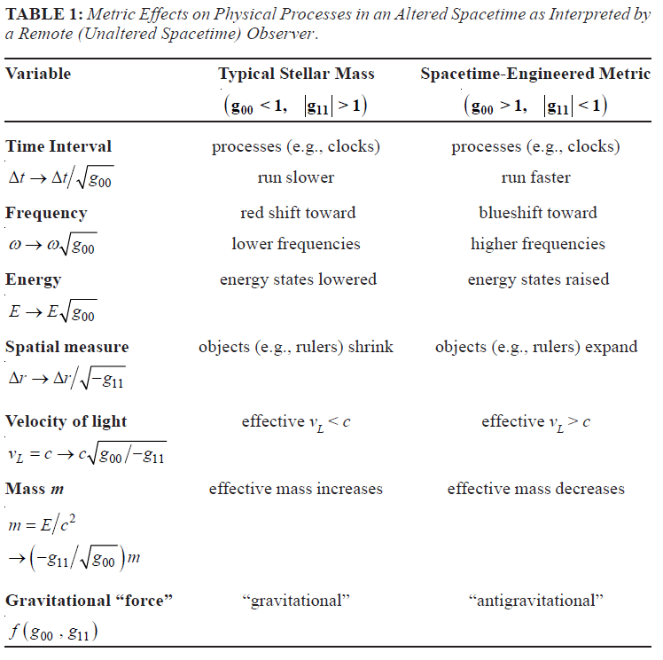
H. E. Puthuff, “Advanced space propulsion based on vacuum (spacetime metric) engineering,” Jour. Brit. Interplanetary Soc. 63 (3), 82-89 (2010).
Basic hypothesis in altered spacetime:
denser spacetime
(g₀₀ < 1, |g₁₁| > 1)
time dilates, length shrinks
“gravitational”
expanded spacetime
(g₀₀ > 1, |g₁₁| < 1)
time shrinks, length dilates
“antigravitational”

Slide 7
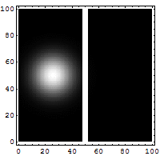
Gravitation exceeds the speed of light in the context of quantum entanglement
Quantum tunneling is an example of the quantum entanglement phenomena. Quantum tunneling is the quantum mechanical phenomenon where a subatomic particle passes through a potential barrier instantaneously. In quantum mechanics the hypothesis is matter [i.e. mass or gravitons] as having properties of both waves and particles. One interpretation of this duality involves the Heisenberg uncertainty principle, which defines a limit on how precisely the position and the momentum of a particle can be known at the same time. This implies that there are no solutions with a probability of exactly zero (or one), though a solution may approach infinity if, for example, the calculation for its position was taken as a probability of 1, the other, i.e. its speed, would have to be infinity[instantaneous]. Hence, the probability of a given particle's existence on the opposite side of an intervening barrier is non-zero, and such particles will appear on the 'other' side (a semantically difficult word in this instance) with a relative frequency proportional to this probability.
In the barrier is where the entanglement occurs, but the protons don't really move, they vibrate. You might say they all sing and dance to the same tune.

Slide 8
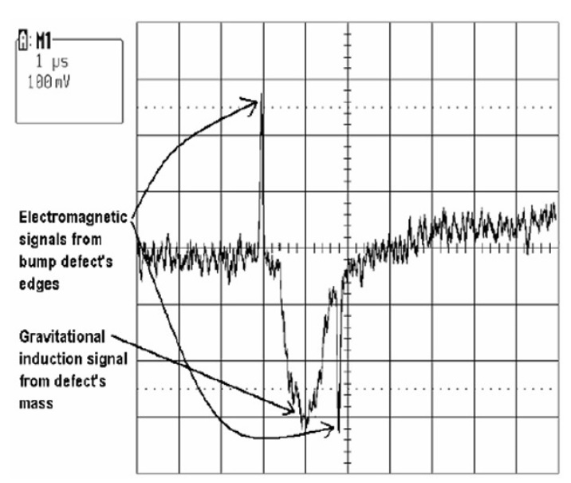
Speed of gravity slower than speed of light in context of frame dragging
Examine the difference between gravito-magnetic induction and [electro-]magnetic induction. A GMR read head signal is observed from a 10μm x 10μm square bump of around 32 nanometer tall on a hard disk platen spinning at a constant linear velocity of 500 inches per second (ips). The disk is spinning counter-clockwise, so we observe the first [electro]-magnetic induction signal on the left as the edge of the square nano-bump moves under GMR sensor. This upward magnetic induction is induced by the 90° change in the angle at the edge of bump at the speed of light. This is followed by the downward gravitomagnetic signal of a bump 1μSecond later traveling at the speed of gravity. We observe the downward polarity second [electro]magnetic induction signal on the right of the gravitomagnetic signal as the edge of the square nano-bump moves under GMR sensor 0.8μSecond later traveling at the speed of light. In this example we observe the gravitational frame dragging is 1μSecond. Voltage is in millivolts (mV).

Slide 9
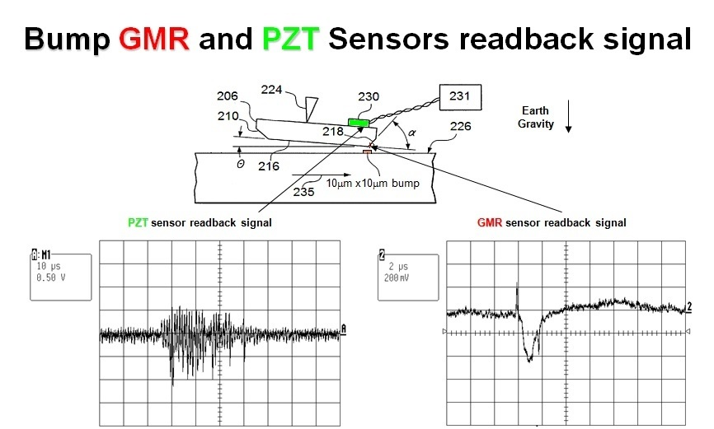
Presence of matter moving produces a pull force and negative polarity gravitomagnetism
The image is of a cross sectional view of the GMR read head with a piezo-electric crystal mounted on the back side of the head slider. The GMR read head is sensitive to magnetic field changes while the piezo-electric crystal on the back of the slider is sensitive to physical motion of the head slider. A 10μm x 10μm square bump of around 32 nanometer height measurement results are shown. On the left is the piezo-electric Glide Head signal where is observed an undamped physical pull against the head slider against the force of Earth Gravity as shown. On the right the GMR sensor shows a negative polarity gravitomagnetic signal. Therefore this infers the presence of matter on the spinning disk produced a physical pull force and negative polarity gravitomagnetism. In this example we observe the gravitational frame dragging is 1μSecond.

Slide 10
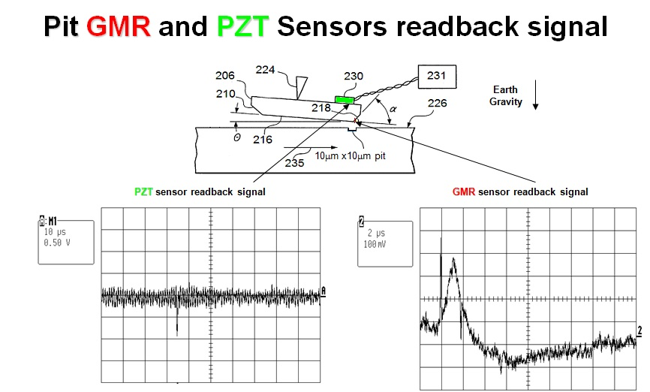
Absence of matter moving produces a push force and positive polarity gravitomagnetism
The image is a cross sectional view of the GMR read head with a piezo-electric crystal mounted on the back side of the head slider with a nano-pit on the surface of the disk. A 10μm x 10μm square pit of around 52 nanometer depth measurement results are shown. On the left is the piezo-electric Glide Head signal where is observed a short dampened physical push against the head slider against the force of Earth Gravity. On the right the GMR sensor shows a positive polarity gravitomagnetic signal. Therefore this infers the absence of matter on the spinning disk produced a push force and positive polarity gravitomagnetism. In this example we observe the gravitational frame dragging is 1μSecond. This also infers there exist two different time frames, one for matter [or the lack there of], and another for electromagnetism [EM].

Slide 11
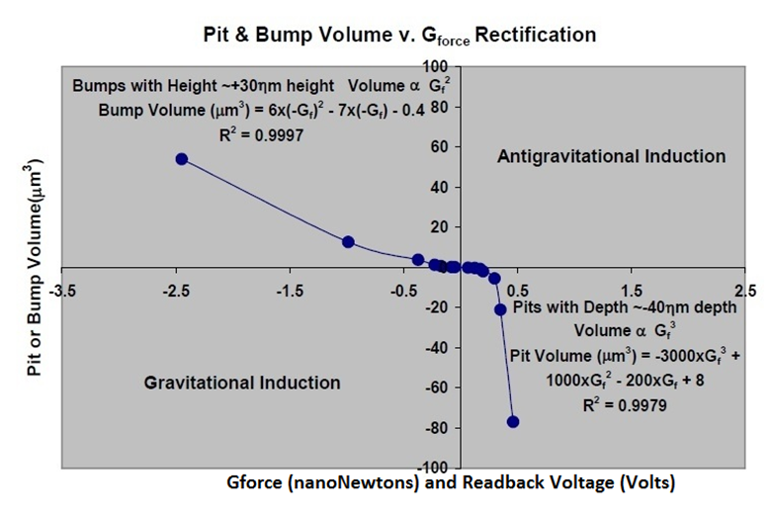
Gravitational junction: parabolic pull force of nano-gravity and hyperbolic push force of nano-antigravity [like a balloon]
A diode is a semiconductor material with a p–n junction connected to two electrical terminals. The p-type side of the junction has an excess of protons [called “holes”], and also called “acceptors”. The n-type side of the junction has an excess of electrons, called “donors”. By varying the area of the nano-pits and the nano-bumps on the surface of the spinning disk the graph of the measured gravitational force is derived. A gravitational diode curve is observed for variable area pits and bumps. The p-type side of the gravitational diode is the acceptor side of junction producing positive gravitational induction and a push force with a third order polynomial of a hyperbolic force like that of a balloon. The n-type side of the gravitational diode is the donor side of the junction producing negative gravitational induction and a pull force with a second order polynomial of a parabolic like that of normal gravity.
1 nanoNewton force = 1 Volt Readback signal as calibrated to Magnetic Force Microscope (MFM) measurements of a 10μm x 10μm square pit of around 200 nanometer depth.

Slide 12
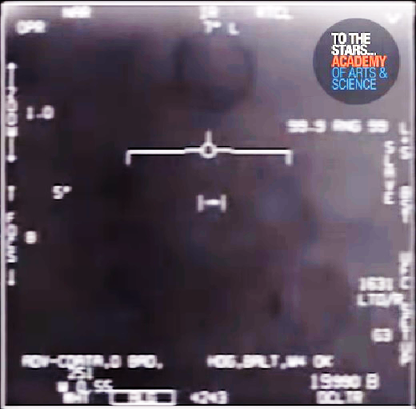
Defining General Relativity Features
Tic Tac shaped Unidentified Aerial
Phenomena (“UAP”)
Balloon shaped brighter region to right of the UAP is warmer on the IR sensors. Under Puthuff hypothesis denser in the lighter balloon? N-side of gravity diode.
Balloon shaped brighter region with moving darker regions to right of and under the UAP is warmer on the IR sensors. Appears as Gravitomagnetism generation and recombination region.
Dark torus shaped balloon rotating counterclockwise above UAP appears cooler on IR than the other regions. Under Puthuff hypothesis expanded spacetime.
Boyd’s antigravity balloon. P-side of gravity diode.
Dark region to left of the UAP under Puthuff hypothesis expanded spacetime. P-side.
Small dark oval shaped balloon rotating to the right and below UAP. P-side.

Slide 13
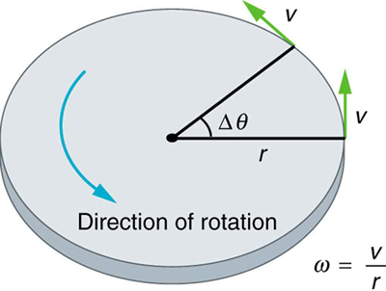
Defining Special Relativity Features
Angular velocity ω is not constant using the loop de loop, there is an angular acceleration, in which ω changes. In equation form, angular acceleration is expressed as: α=Δω/Δt, where Δω is the change in angular velocity and Δt is the change in time. If ω increases, then α is positive.
Expanded spacetime (g₀₀ > 1, |g₁₁| < 1) time shrinks, length dilates “antigravitational” propulsion

Slide 14
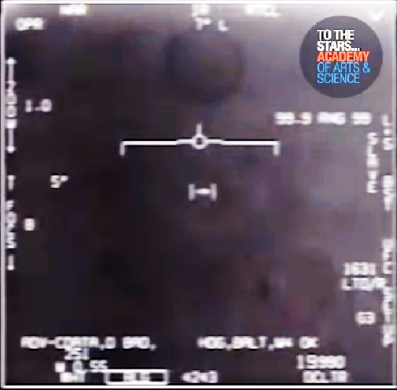
TTSA/ U.S. Navy Tic Tac Video: T= 2.23-1
Magnification: 1X
Observations: Dark torus shaped balloon rotating counterclockwise above UAP. Dark region to left of the UAP. Small dark oval shaped balloon rotating to the right and below UAP. Balloon shaped brighter region to right of the UAP and Balloon shaped brighter region with moving darker regions to right of the UAP.

Slide 15
TTSA/ U.S. Navy Tic Tac Video: T= 2.23-2
Observations: Dark torus shaped balloon rotating counterclockwise above UAP. Dark region to left of the UAP. Small dark oval shaped balloon rotating to the right and below UAP. Balloon shaped brighter region to right of the UAP and Balloon shaped brighter region with moving darker regions to right of the UAP.
Magnification: 1X

Slide 16
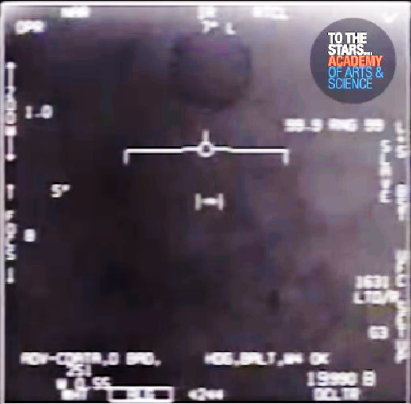
TTSA/ U.S. Navy Tic Tac Video: T= 2.23-3
Magnification: 1X
Observations: Dark torus shaped balloon rotating counterclockwise above UAP. Dark region to left of the UAP. Small dark oval shaped balloon rotating to the right and below UAP. Balloon shaped brighter region to right of the UAP and Balloon shaped brighter region with moving darker regions to right of the UAP.

Slide 17
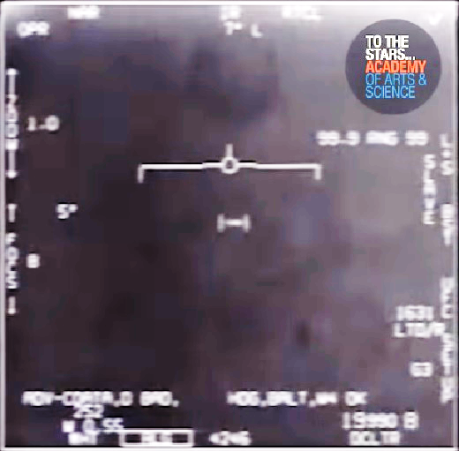
TTSA/ U.S. Navy Tic Tac Video: T= 2.26-1
Magnification: 1X
Observations: Dark torus shaped balloon rotating counterclockwise above UAP. Dark region to left of the UAP. Small dark oval shaped balloon rotating to the right and below UAP. Balloon shaped brighter region to right of the UAP and Balloon shaped brighter region with moving darker regions to right of the UAP.

Slide 18
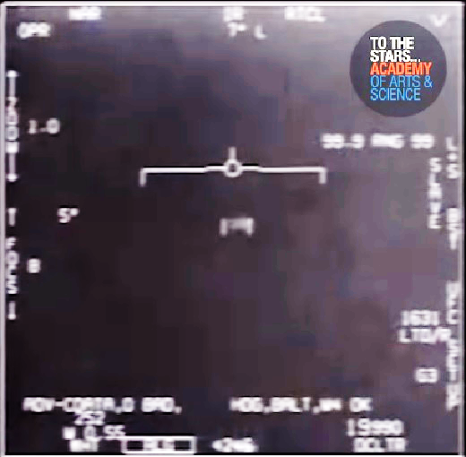
TTSA/ U.S. Navy Tic Tac Video: T= 2.26-2
Magnification: 1X
Observations: Dark torus shaped balloon above UAP is gone. UAP appears to be moving at a high rate of speed within a short distance.

Slide 19
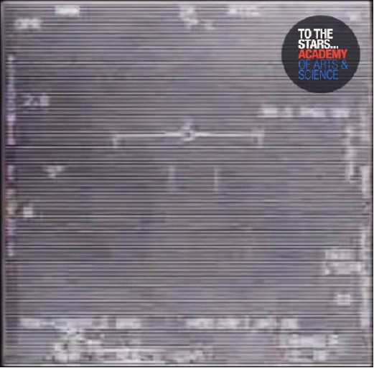
TTSA/ U.S. Navy Tic Tac Video: T= 2.26-3
Magnification: ??
Observations: IR Detector Array appears to be saturated by heating in detector array fanout. Detector array is packaged and housed in cryogenic cooled vacuum chamber.

Slide 20
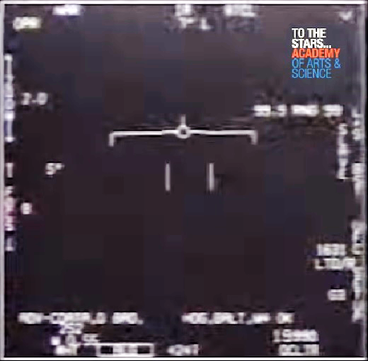
TTSA/ U.S. Navy Tic Tac Video: T= 2.26-4
Magnification: 2X
Observations: UAP disappears as sensor background goes black.

Slide 21
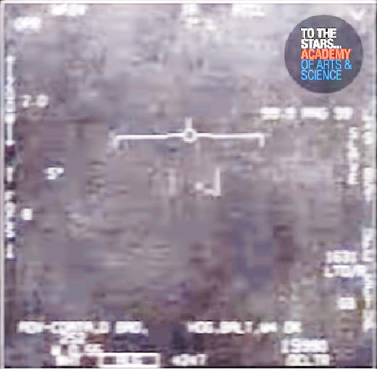
TTSA/ U.S. Navy Tic Tac Video: T= 2.26-5
Magnification: 2X
Observations: shrunken UAP appears in cross-hatched partially saturated sensor background.

Slide 22
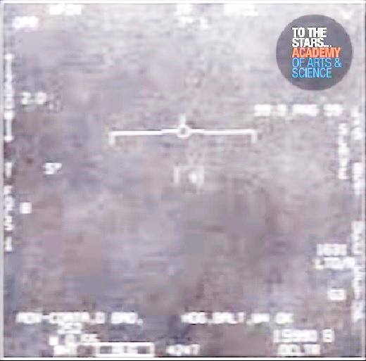
TTSA/ U.S. Navy Tic Tac Video: T= 2.26-6
Magnification: 2X
Observations: shrunken UAP continues to appear in cross-hatched partially saturated sensor background.

Slide 23
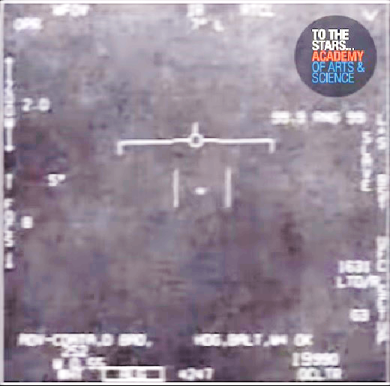
TTSA/ U.S. Navy Tic Tac Video: T= 2.27-1
Magnification: 2X
Observations: shrunken UAP moves left rapidly expanding length slightly and appears in cross-hatched less partially saturated sensor background.

Slide 24
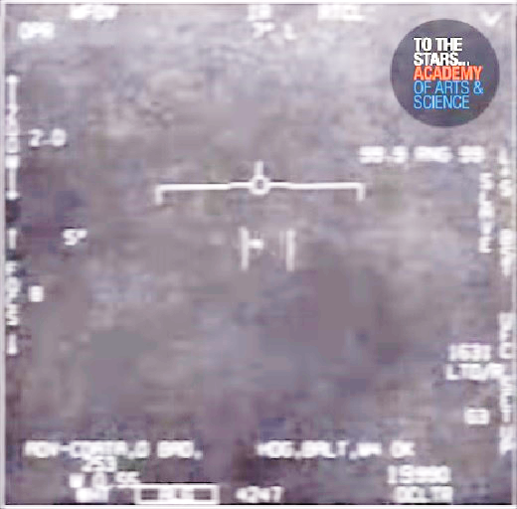
TTSA/ U.S. Navy Tic Tac Video: T= 2.27-2
Magnification: 2X
Observations: shrunken UAP appears to move left and up. UAP continues to appear in cross-hatched partially saturated sensor background.

Slide 25
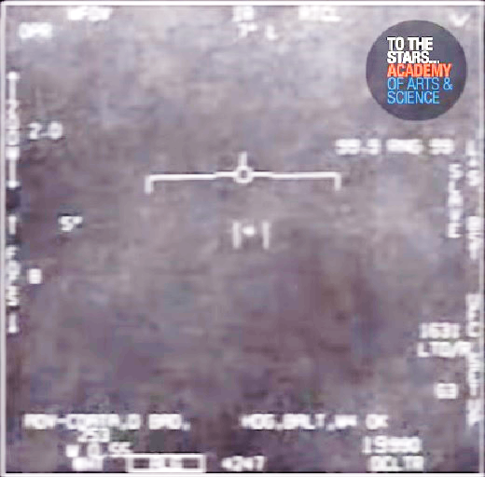
TTSA/ U.S. Navy Tic Tac Video: T= 2.27-3
Magnification: 2X
Observations: shrunken UAP appears to move right. UAP continues to appear in cross-hatched partially saturated sensor background.

Slide 26
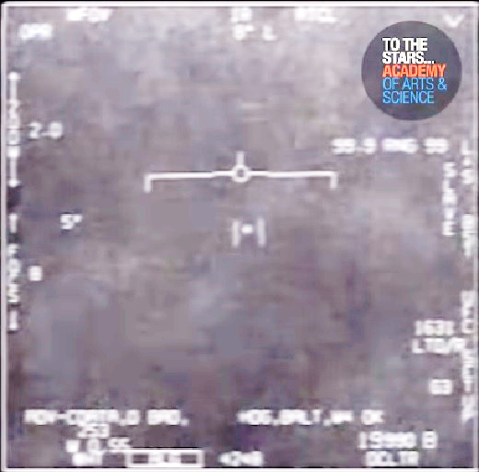
TTSA/ U.S. Navy Tic Tac Video: T= 2.27-4
Magnification: 2X
Observations: : shrunken UAP continues to move right. UAP continues to appear in cross-hatched partially saturated sensor background.

Slide 27
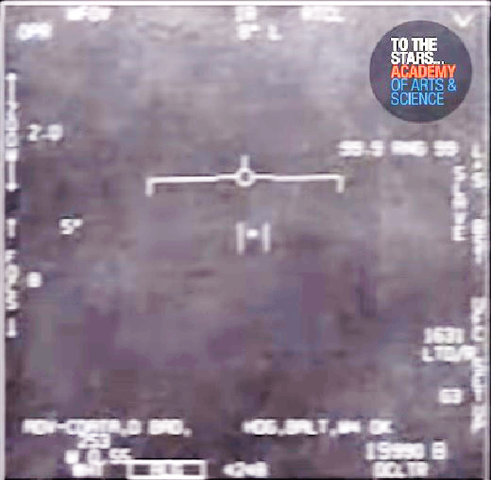
TTSA/ U.S. Navy Tic Tac Video: T= 2.27-5
Magnification: 2X
Observations: shrunken UAP appears to maintain position. Cross-hatched partially saturated sensor background declines in saturation.

Slide 28
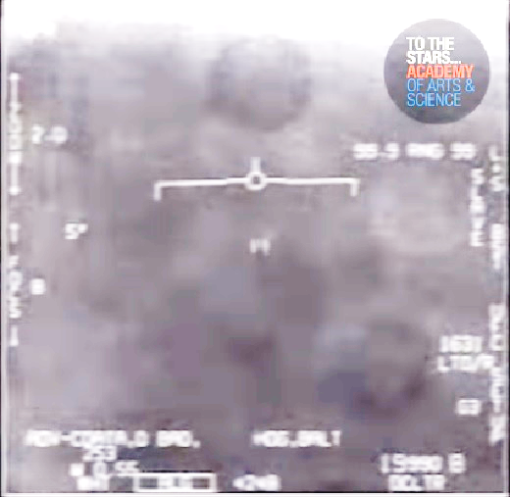
TTSA/ U.S. Navy Tic Tac Video: T= 2.28-1
Magnification: 2X
Observations: UAP appears to shrink smaller and move rapidly. Dark balloon above UAP appears. Dark region to left of the UAP. Balloon shaped brighter region to right of the UAP and balloon shaped darker region with inner moving lighter regions to right of and below the UAP. UAP continues to appear in partially saturated sensor background.

Slide 29
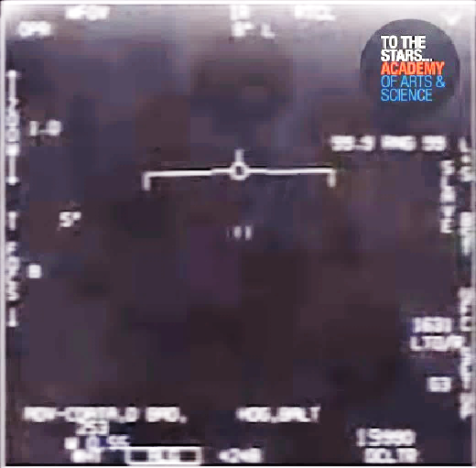
TTSA/ U.S. Navy Tic Tac Video: T= 2.28-2
Magnification: 1X
Observations: UAP appears to shrink smaller. Dark balloon above UAP. Dark region to left of the UAP. Balloon shaped brighter region to right of the UAP and balloon shaped darker region regions to right of and below the UAP. Sensor background no longer saturated.

Slide 30
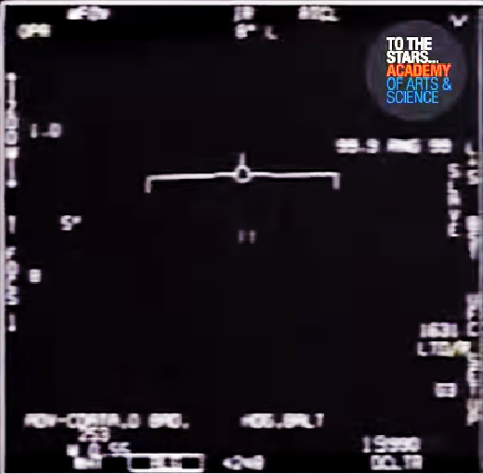
TTSA/ U.S. Navy Tic Tac Video: T= 2.28-3
Magnification: 1X
Observations: UAP disappears as sensor background goes black.

Slide 31
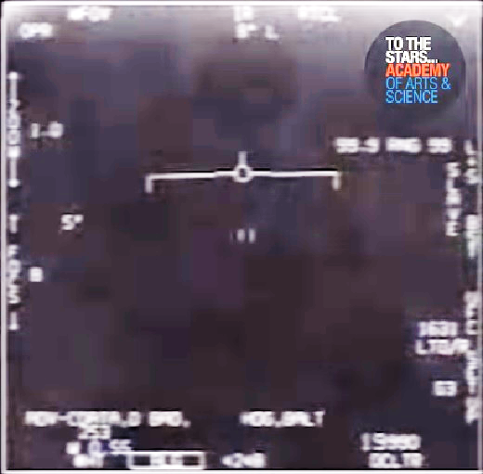
TTSA/ U.S. Navy Tic Tac Video: T= 2.28-4
Magnification: 1X
Observations: UAP reappears at same size. Dark balloon above UAP. Dark region to left of the UAP. Balloon shaped brighter region to right of the UAP and balloon shaped darker region regions to right of and below the UAP. Sensor background no longer saturated.

Slide 32
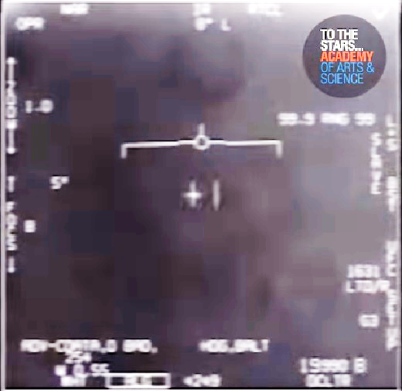
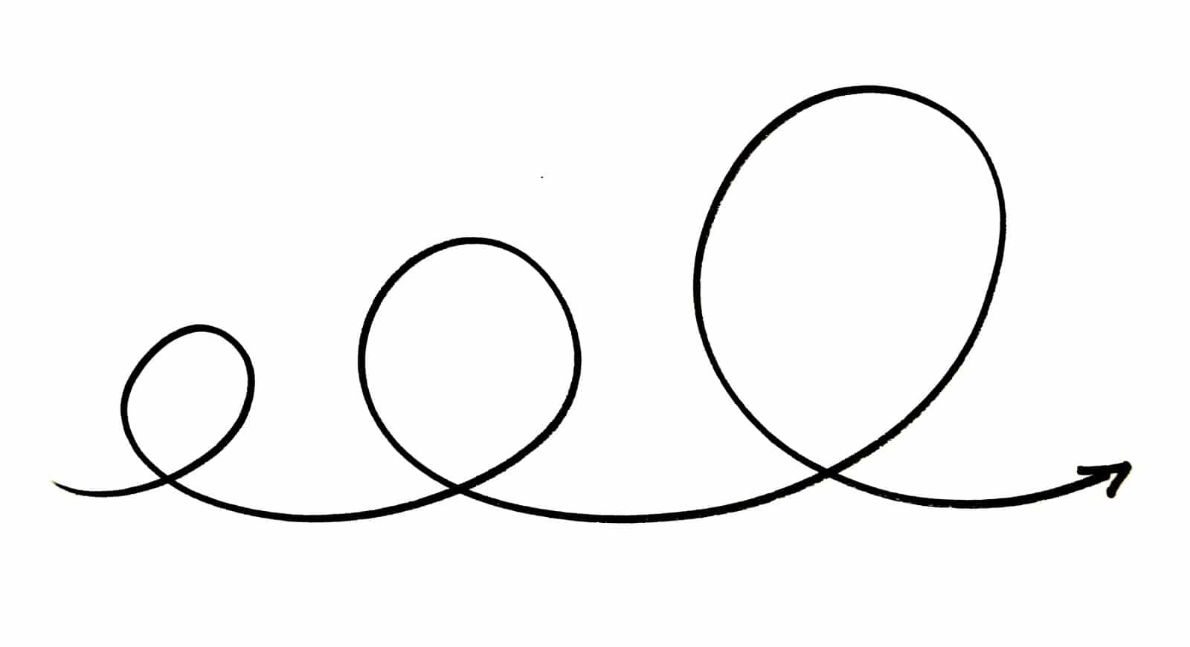
TTSA/ U.S. Navy Tic Tac Video: T= 2.28-5
Magnification: 1X
Observations: UAP turns and moves left rapidly with increased visual length. Dark balloon above UAP turns brighter towards the right and darker towards the left. Dark region to left of the UAP brighter region to right of the UAP. UAP appears to enter a loop de loop. Egg shaped dark region to right and below UAP appears.
[See image]

Slide 33
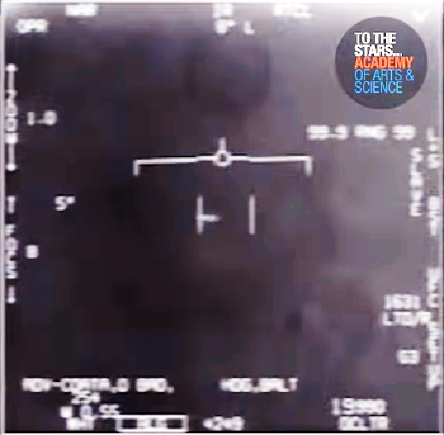
TTSA/ U.S. Navy Tic Tac Video: T= 2.28-6
Magnification: 1X
Observations: UAP increased visual length. Dark balloon above UAP. Dark region to left of the UAP brighter region to right of the UAP. Egg shaped dark region to right and below UAP. UAP appears to be in a loop de loop.

Slide 34
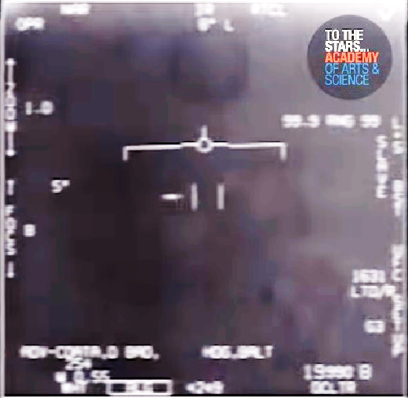
TTSA/ U.S. Navy Tic Tac Video: T= 2.28-7
Magnification: 1X
Observations: UAP continues left with increased visual length Dark balloon above UAP turns brighter towards the center and darker towards the edge. Dark region to left of the UAP brighter region to right of the UAP. Egg shaped dark region to right and below UAP. UAP appears to be in a loop de loop.

Slide 35

TTSA/ U.S. Navy Tic Tac Video: T= 2.28-8
Magnification: 1X
Observations: UAP appears to go down and right slightly with increased visual length. Dark balloon above UAP. Dark region to left of the UAP brighter region to right of the UAP. Egg shaped dark region to right and below UAP. UAP appears to be in a loop de loop.

Slide 36
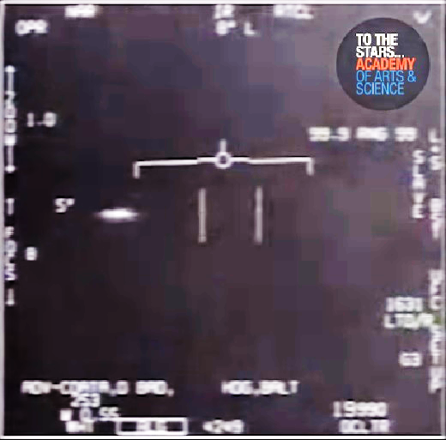
TTSA/ U.S. Navy Tic Tac Video: T= 2.29-1
Magnification: 1X
Observations: UAP continues left with 2X increased visual length. Dark balloon above UAP is gone. Dark region to left of the UAP brighter region to right of the UAP. UAP appears to be entering into another loop de loop.

Slide 37
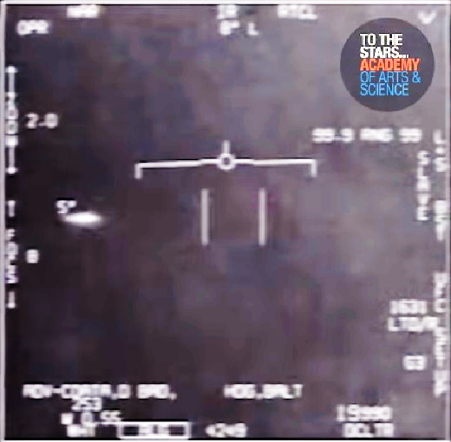
TTSA/ U.S. Navy Tic Tac Video: T= 2.29-2
Magnification: 2X
Observations: UAP continues left with 2X increased visual length and down slightly appearing to be turning. Dark balloon above UAP is gone. Dark region to left of the UAP brighter region to right of the UAP. UAP appears to be in a loop de loop.

Slide 38
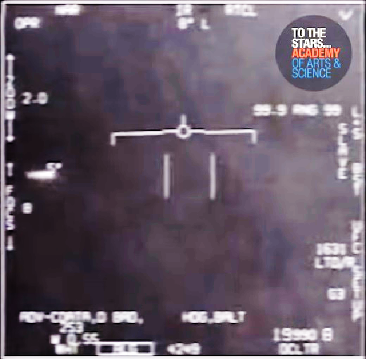
TTSA/ U.S. Navy Tic Tac Video: T= 2.29-3
Magnification: 2X
Observations: UAP continues left with increased visual length and up slightly appearing to be turning. UAP appears to be in a loop de loop.

Slide 39
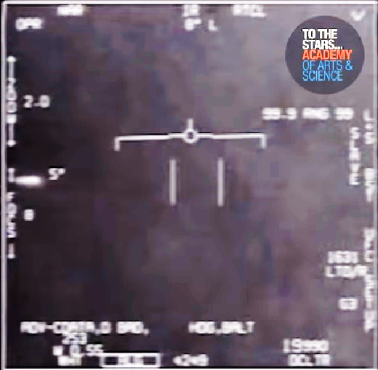
TTSA/ U.S. Navy Tic Tac Video: T= 2.29-4
Magnification: 2X
Observations: UAP continues left with increased visual length and to be turning away from the IR sensor. UAP appears to be in a loop de loop.

Slide 40
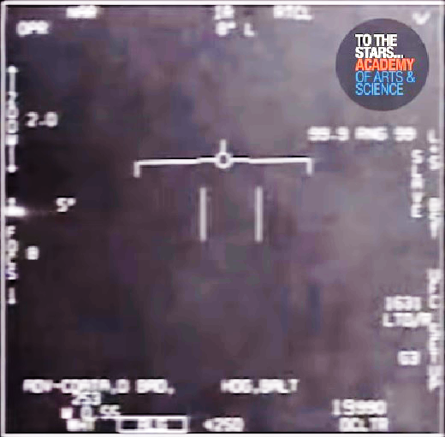
TTSA/ U.S. Navy Tic Tac Video: T= 2.29-5
Magnification: 2X
Observations: UAP continues left with increased visual length and to be turning away from the IR sensor. UAP appears to be in a loop de loop.

